Slide 1
Lesson 3 & 4: Encoding Images
Day 14
We Beat Texas!

Slide 2
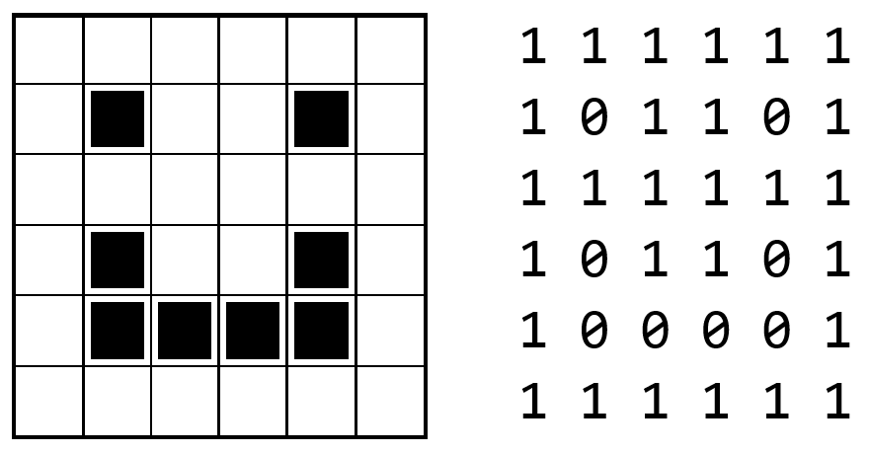
Review
Lesson 1 & 2 Quiz
Review Activity From Yesterday

Slide 3
Encoding Black and White Images
explore the way digital images are encoded in binary
Image - A type of data used for graphics or pictures.
metadata - is data that describes other data. For example, a digital image my include metadata that describe the size of the image, number of colors, or resolution.
pixel - short for "picture element" it is the fundamental unit of a digital image, typically a tiny square or dot which contains a single point of color of a larger image.

Slide 4
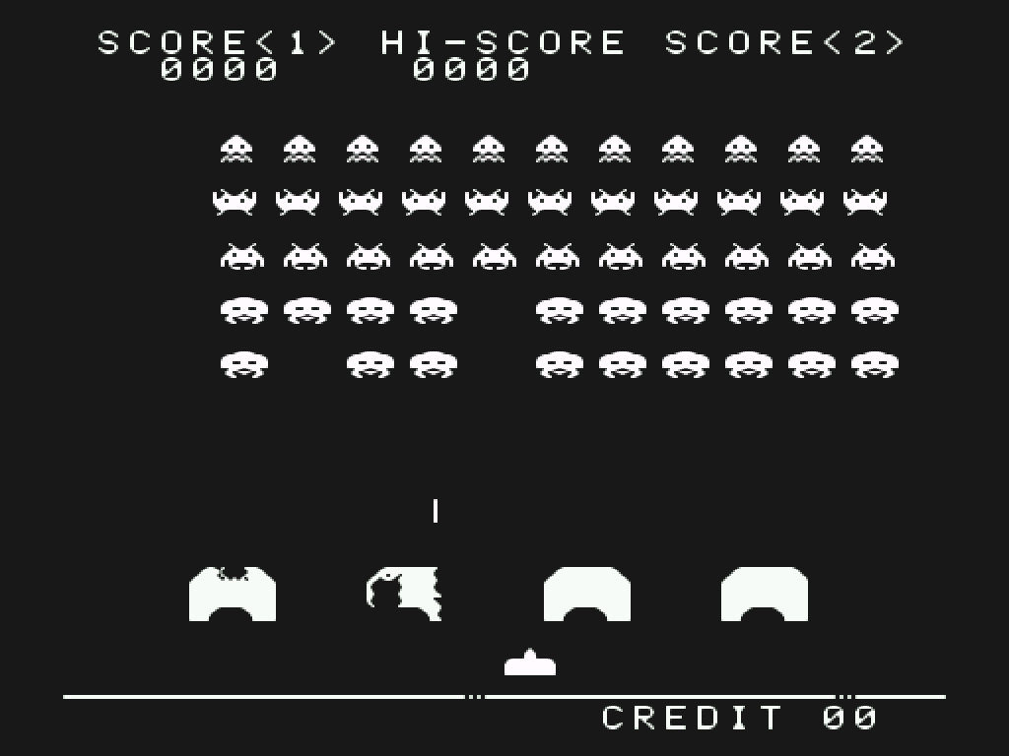

Slide 5
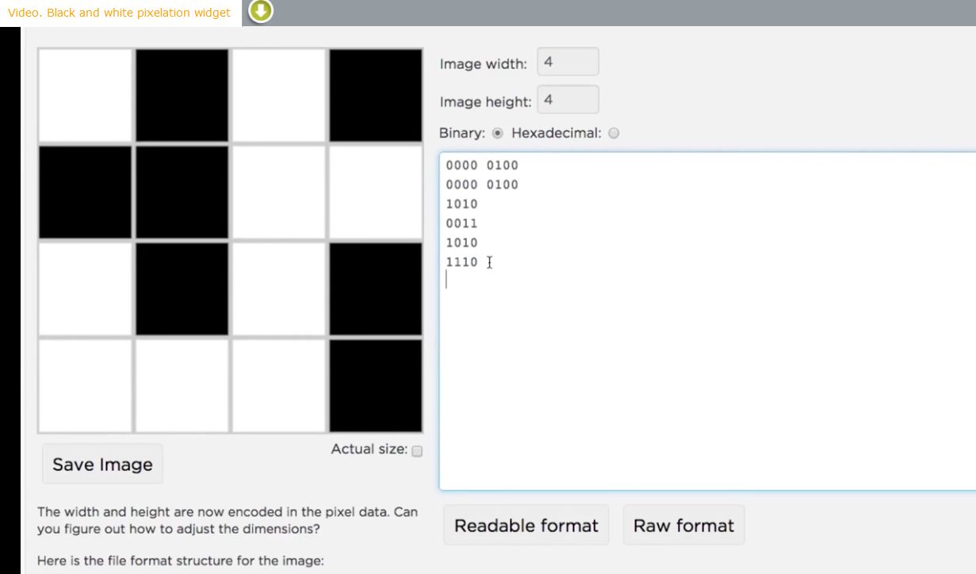
Video- The Pixelation Widget

Slide 6
Try the Pixelation Widget & Complete Lesson 3

Slide 7
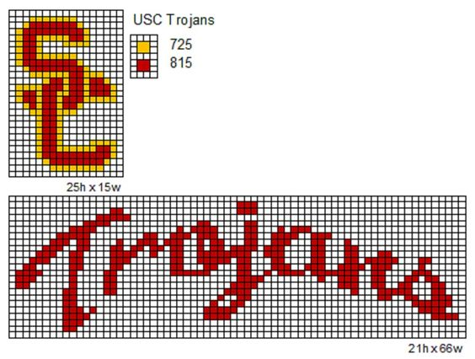
2 Videos
A little bit about Pixels
Color Pixelation Widget

Slide 8
Try the Color Pixelation Widget 8 Bit Color

Slide 9
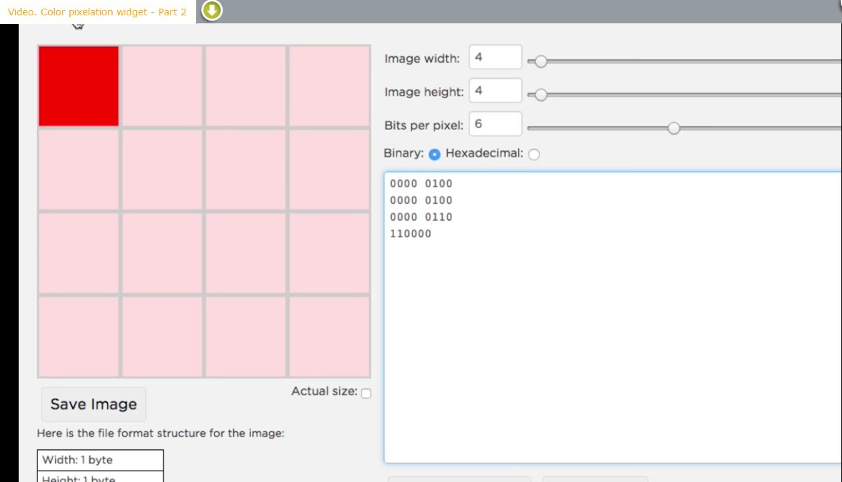
Try the Color Pixelation Widget More Colors- Part 2
Video Part 2
Color Pixelation Widget Part 2

Slide 10
Try the Color Pixelation Widget Even More Colors
Video- Color Pixelation Widget Part 3
Try it!

Slide 11
Review
Vocabulary

